Slide 1

Cohort: S24
Course name: Web Engineering
Professor: Clément ZIANE
https://www.datasciencetech.institute

Slide 2



Web Engineering
Introduction to Back-End

Slide 3
Which Tools ?
In this class we use ASP.NET
Framework .NET
Razor Markup Language
Entity Framework
SQL Database
3

Slide 4
Web Communication
Browser
Request
Application
Response
4

Slide 5
Request
Method
Destination
Parameters
Request type
5

Slide 6
Request : Method (1/4)
GET is used to request data from a specified resource.
Protocol://URL/path/to/resources?param1=Value1&param2=Value2
6

Slide 7
Request : Method (2/4)
POST is used to send data to a server to create/update a resource.
The data sent to the server with POST is stored in the request body of the HTTP request:
7

Slide 8
Request : Method (3/4)
PUT is used to send data to a server to create/update a resource.
The difference between POST and PUT is that PUT requests are idempotent. That is, calling the same PUT request multiple times will always produce the same result. In contrast, calling a POST request repeatedly have side effects of creating the same resource multiple times.
8

Slide 9
Request : Method (4/4)
DELETE method deletes the specified resource.
9

Slide 10
Architecture
Model View Controller

Slide 11
MVC
Model–view–controller (MVC) is a software design pattern commonly used for developing user interfaces that divide the related program logic into three interconnected elements.
This is done to separate internal representations of information from the ways information is presented to and accepted from the user
11

Slide 12
MVC : Illustration
Model
View
User Interface
Internal Information
Controller
Formated Data
User
12

Slide 13
MVC : Model
The model is part of the application to retrieve the core data. Example : Request Database For this part we will use Entity Framework (Tomorrow Session)
13

Slide 14
MVC : View
The view is the part of the application to build the html pages. We’ll use in this class razor template engine.
14

Slide 15
MVC : Controller
The controller is the part of the application used to link model view and drive the user requests. It will take the user request and call the model and view to build formatted data for the user. It’s also used to perform the change needed by the user.
15

Slide 16
MVC : Router
This is a specificity for Web Application.
We need a module to analyze and parse the request from the user and decide which “Route” to use to achieve the desired goal.
16

Slide 17
ASP.NET
C# for web

Slide 18
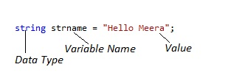
Syntax : Variables
Variables are typed.
18

Slide 19
Syntax : Loops & iterations (1/2)
//for ([initialExpression]; [conditionExpression]; [incrementExpression])
for (int i = 0; i < 5; i++) {
// Runs 5 times, with values of step 0 through 4.
console.log('Walking east one step');
}
//while (condition)
int n = 0;
int x = 0;
while (n < 3) {
n++;
x += n;
}
19

Slide 20
Syntax : Loops & iterations (2/2)
var fibNumbers = new List<int> { 0, 1, 1, 2, 3, 5, 8, 13 };
foreach (int element in fibNumbers)
{
Console.Write($"{element} ");
}
// Output:
// 0 1 1 2 3 5 8 13
20

Slide 21
Syntax : Conditional Expression (1/2)
string result;
int a=5
if (a > 0)
{
result = 'positive’;
}
else // if
{
result = 'NOT positive’;
}
21

Slide 22
Syntax : Data Structures
Array :
// Declare a single-dimensional array of 5 integers.
int[] array1 = new int[5];
// Declare and set array element values.
int[] array2 = new int[] { 1, 3, 5, 7, 9 };
// Alternative syntax.
int[] array3 = { 1, 2, 3, 4, 5, 6 };
// Declare a two dimensional array.
int[,] multiDimensionalArray1 = new int[2, 3];
// Declare and set array element values.
int[,] multiDimensionalArray2 = { { 1, 2, 3 }, { 4, 5, 6 } };
// Declare a jagged array.
int[][] jaggedArray = new int[6][];
// Set the values of the first array in the jagged array structure.
jaggedArray[0] = new int[4] { 1, 2, 3, 4 };
22

Slide 23
Syntax : Data Structures
List is the simplest dynamic datastructure
List<string> authors = new List<string>(); Dictionary is a Key-Value DataStructure
Dictionary<int, string> numberNames = new Dictionary<int, string>();
23

Slide 24
Syntax : Object Oriented Programming
public class Employee : Person
{
public int EmpId { get; set; }
public string Name { get; set; }
//constructor
public Employee(int id, string name) : base(name){
this.EmpId = id;
this.Name = name;
}
public void DisplayEmpInfo() {
Console.WriteLine(this.EmpId + " " this.Name);
}
}
24

Slide 25
Razor
Introduction to Templating

Slide 26
What is it ?
Razor is a Template Engine. It’s mean it’s use to create html file dynamically from ASP.Net.
Razor use cshtml file ( for C# HTML)
The language use tags @ to operate.
26

Slide 27
Define variable
@{ string helloWorldMsg = "Hello, world!"; }
27

Slide 28
If/else
@if(DateTime.Now.Year >= 2042) { <span>The year 2042 has finally arrived!</span> } else { <span>We're still waiting for the year of 2042...</span> }
28

Slide 29
Loop : For
<ul> @for (int i = 0; i < names.Count; i++) { <li>@names[i]</li> } </ul>
29

Slide 30
Loop : Foreach
<ul> @foreach (string name in names) { <li>@name</li> } </ul>
30

Slide 31
Loop : While
<ul> @{ int counter = 0; } @while(counter < names.Count) { <li>@names[counter++]</li> } </ul>
31

Slide 32
Local Functions
@{ void RenderUserInfo(User user) { <div class="user-info"> @user.LastName, @user.FirstName </div> } }
32

Slide 33
View Data
The ViewData is a variable (data structure) used to pass data to the Razor View.
@page
@model IndexModel
@{
var book = (Book)ViewData["MyComplexObject"];
}
<h2>@book.Title</h2>
<p>@book.Author.Name</p>
<p>@book.Price</p>
33

Slide 34
Entity Framework
Database to Objects

Slide 35
How to install ?
Use the nugget manager to install
Microsoft.EntityFrameworkCore
Microsoft.EntityFrameworkCore.SqlServer
Mysql.EntityFrameworkCore You need a SQL DB.
35

Slide 36
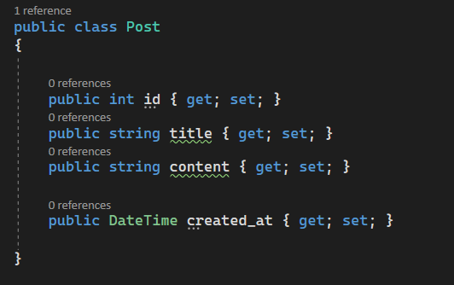
Create the Model
Create a Class Post with attribute corresponding to your database table posts.
36

Slide 37
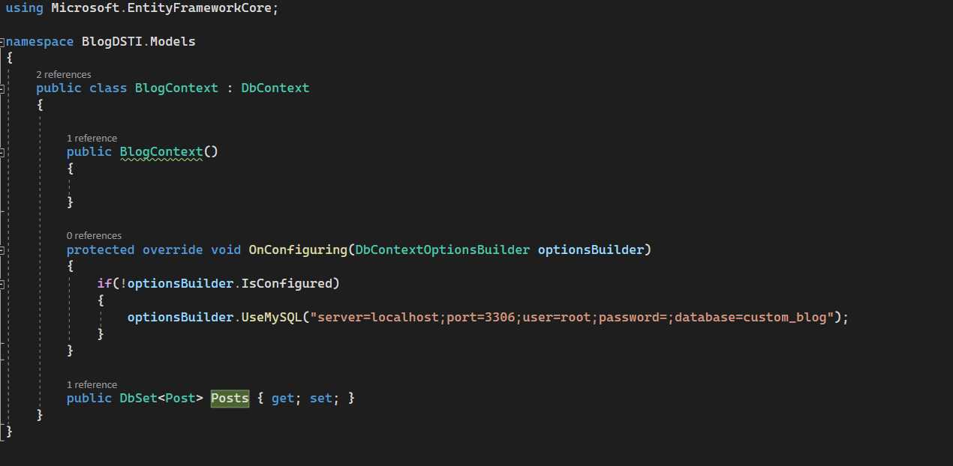
Create the context
Create a Context to connect and pull the database
37

Slide 38
CRUD Operations
CRUD Operations are Basic Operations with Database :
Create
Request
Update
Delete
38

Slide 39
Crud Operations : Select
Select All
Where Clause (Line-Q)
using (var context = new BlogContext()) {
var query = context.Posts
.where(p => p.title == "title")
.FirstOrDefault<Post>();
}
using (var context = new BlogContext()) {
var posts = context.Posts
.ToList()
}
39

Slide 40
Crud Operations : Update
using (var context = new BlogContext()) {
post.title="New Title"
context.Posts.AddOrUpdate(post);
context.SaveChanges();
}
using (var context = new BlogContext()) {
context.RemoveRange(db.Posts.Where(x => x.title == "title"));
}
40

Slide 41
Crud Operations : Delete
using (var context = new BlogContext()) {
var post = new Post{id=1}
context.Posts.Attach(post);
context.Posts.Remove(post);
context.SaveChanges();
}
41

Slide 42
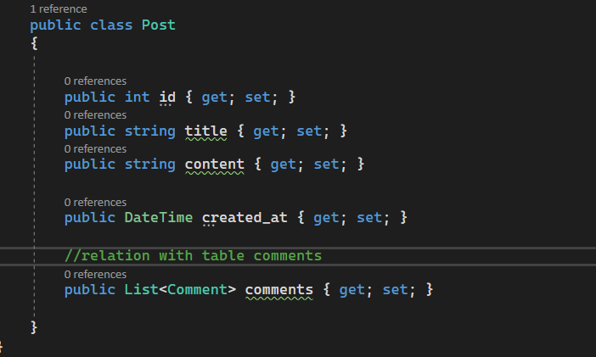
Relations
Relations can be automatically created based one your model
42

Slide 43
Questions ?
Ask them all !

